Slide 1
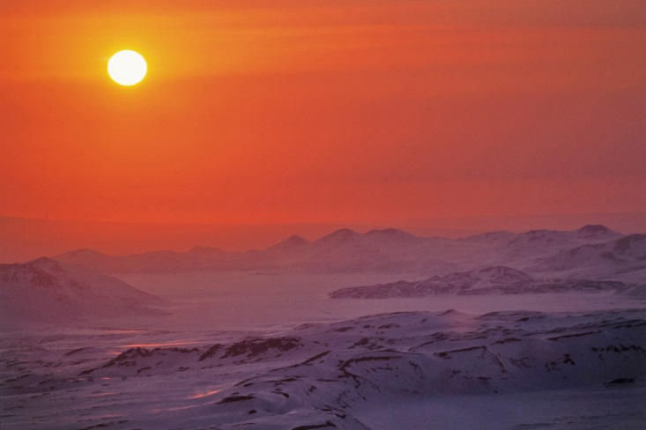
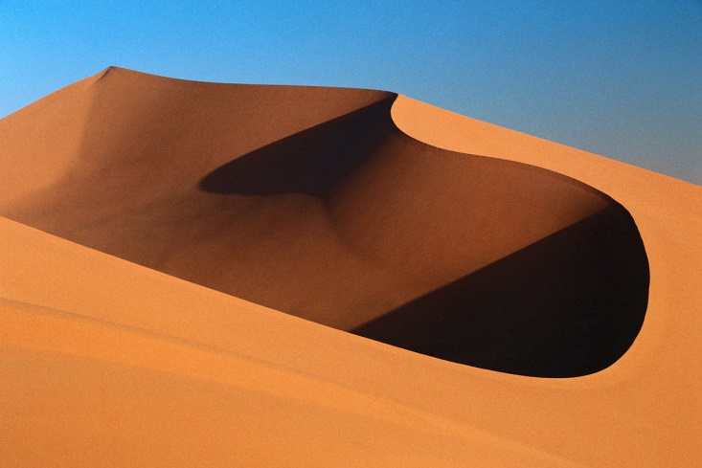
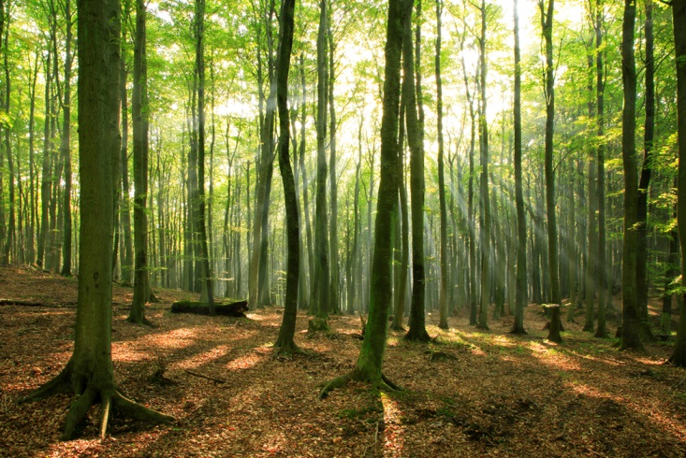
Biomes
Class website: www.hindsscience10. weebly.com

Slide 2
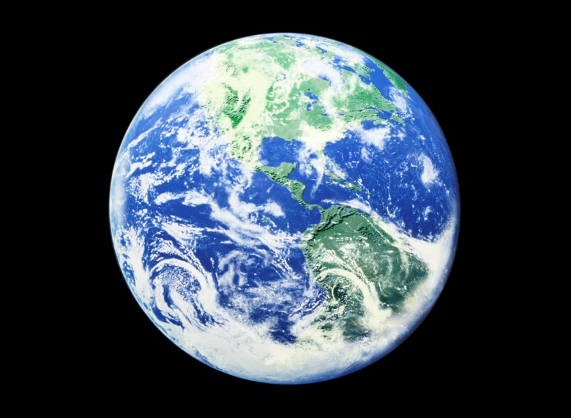
Chapter 1 Vocab
Abiotic You are expected to keep track
Adaptation of vocab in your binder for each
Biome chapter. Random hw checks will
Biotic be done.
Climate
Climatograph
Commensalism
Competition
Ecosystem
Mutualism
Niche
Parasitism
Predation
symbiosis

Slide 3
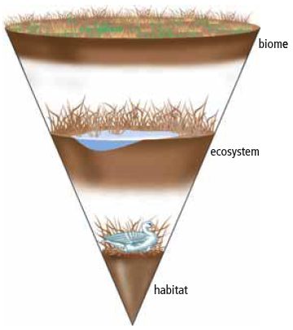
BBECPO
B-Biosphere
B-Biome
E-Ecosystem
C-Community
P-Population
O-Organism

Slide 4
Biome
A biome is a region with similar biotic and
abiotic components.
    Biotic = living things
    Abiotic = non-living things (air, water, soil, etc.)
  If biotic and abiotic conditions are the same, similar
  biomes can exist far apart. Ex- BC same as New Zealand
  Examples of Biomes: Boreal forest, desert, grassland, permanent ice, temperate deciduous forest, temperate rainforest, tropical rainforest, and tundra.
Notes:
-A biome here in B.C. can be the same as a biome in New Zealand.
-Biomes are classified based on many qualities, such as water availability, temperature, and interactions between biotic and abiotic factors.

Slide 5

Biotic vs Abiotic
Living organisms
  Plants
  Animals
  Fungi
  Bacteria
Non living
  Sunlight
  Soil
  Moisture
  Temperature

Slide 6
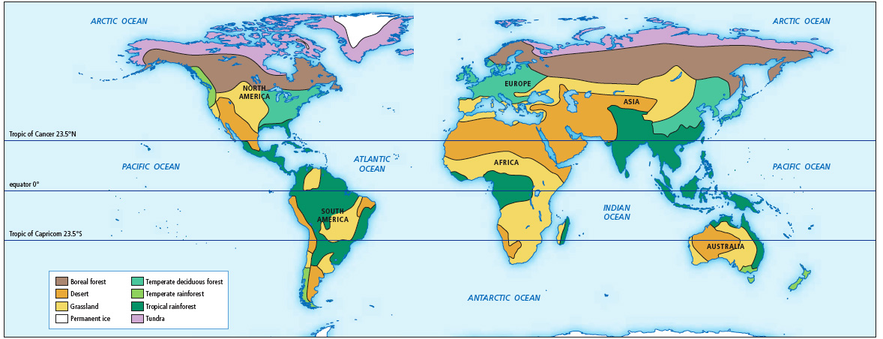
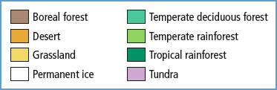
Factors that Influence the Characteristics and Distribution of Biomes
Certain characteristics help to identify biomes.
  Temperature and precipitation are two of the
  most important abiotic factors.
  Other factors include latitude, elevation, and
  ocean currents.
Biomes of the World
See pages 10 - 13

Slide 7
Biomes Worksheet

Slide 8
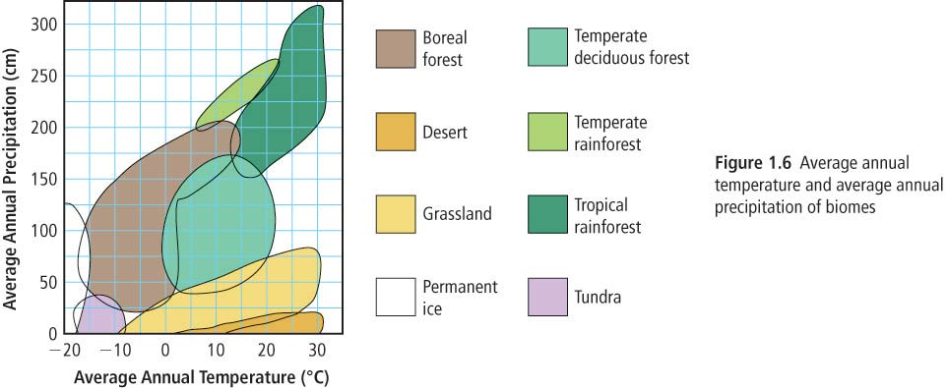
Influencing Factors
Temperature
Precipitation (rainfall, snow, mist & fog)
Latitude
Elevation
Ocean Currents

Slide 9
Influencing factors
Latitude is an abiotic factor that influences biomes.
  Latitude is the distance north and south from the equator.
  Latitude influences both temperature and precipitation.
    The tropical zone has very warm temperatures and high precipitation.
    The tropical zone receives more direct sunlight than do temperate zones.
Elevation also influences biomes.
  The atmosphere is thinner at higher elevations, and therefore less heat is retained.
  Windward sides of mountains are wet, leeward sides are very dry.
Ocean currents carry warmth and moisture to coastal areas.
  Where warm currents meet land, temperate biomes are found.

Slide 10
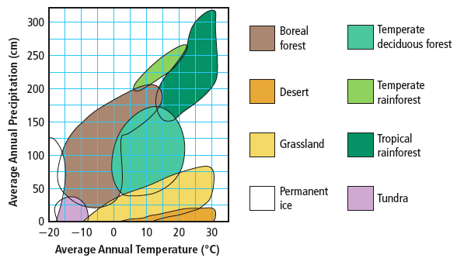
How to read a graph

Slide 11
Practice Problems pg. 13
Identify the biome
  1. the region has an average annual precipitation of about 175 cm and an average annual temperature of 5 degrees Celsius.
  2. the region ranges in temperature between 0 and 20 degrees and receives about 100 cm of rain
  3. The region has low average annual precipitation and an average annual temperature that ranges between -18 and -8 degrees.
  4. The region has high average annual precipitation and an average annual temperature.

Slide 12
Practice Problem Answers
1. Boreal forest
2. Temperate deciduous forest
3. Tundra
4. Temperate rainforest

Slide 13
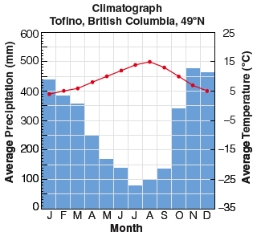
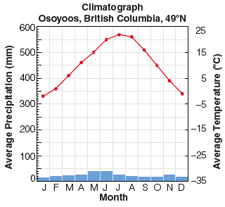
Climatographs
Climate refers to the average pattern of weather conditions of a large region over a period of 30 years or more.
  A climatograph shows the average temperature and precipitation for a location over a period of 30 years or more.
  Examine the differences between the climatographs for Tofino and Osoyoos

Slide 14

Lab 1-1C
Get into partners
Start to work on parts 1-3
Grab a piece of graph paper
For a climatograph.

Slide 15
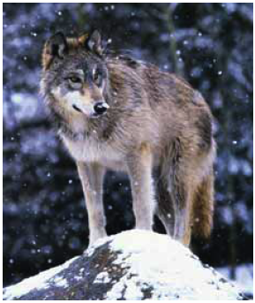
Adaptations and Biomes
Biomes are often identified with characteristic biotic factors,
  such as a cactus in the desert or a caribou on the tundra.
  Many of these characteristic factors have special adaptations for that biome.
  An adaptation is a characteristic that allows an organism to better survive and reproduce.
    Structural adaptation – a physical feature that helps an organism survive
      A wolf has large paws to help it run in snow.
    Physiological adaptation – a physical or chemical event
    inside the body of an organism that allows it to survive
      A wolf maintains a constant body temperature.
    Behavioural adaptation – a behaviour that helps an
    organism to survive
      Wolves hunt in packs to capture large prey.

Slide 16
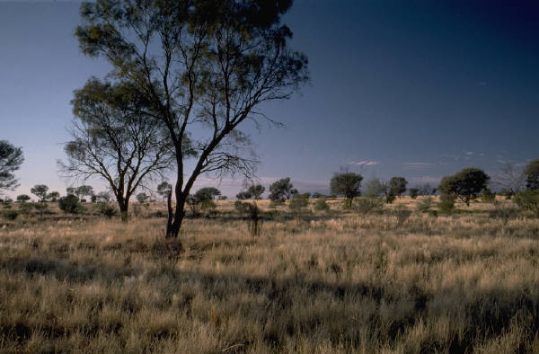
A survey of Biomes
Tundra
Boreal Forest
Temperate Deciduous Forest
Temperate Rainforest
Grassland (Temperate and Tropical)
Tropical Rainforest
Desert (Hot and Cold)
Permanent Ice (Polar Ice)

Slide 17
Biomes
Get into 8 groups
Each group must fill out handout on their own biome
Present their biome to the class.

Slide 18
Ch 1.1 Biomes
Reading check pages
  Pg 12
  Pg 15
  Pg 19
  Pg 25
  Pg 29
  Check your understanding questions pg 33

